Slide 1

به کارگیری موثر پردازنده گرافیکی در تست نرم افزار
ارائه‌ی اختیاری درس آزمون نرم افزار علیرضا ابره فروش بهار ۱۴۰۲

Slide 2
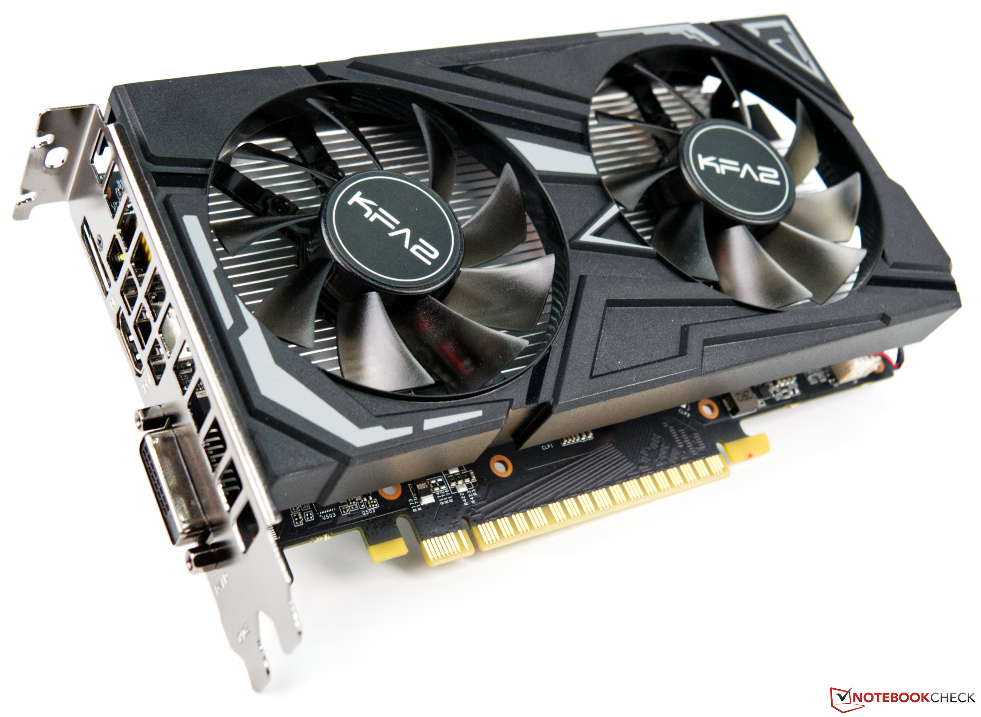
Tech Requirements
INtroduction

Slide 3
Tech Requirements
Contrasting approach with existing literature on GPGPU
This approach leaves the program and its logic untouched, focusing on parallelizing test case execution.
No program transformation from CPU to GPU program is required.
Original program logic is maintained, ensuring the same results as CPU testing.

Slide 4
1 testcase per 1 gpu thread

Slide 5
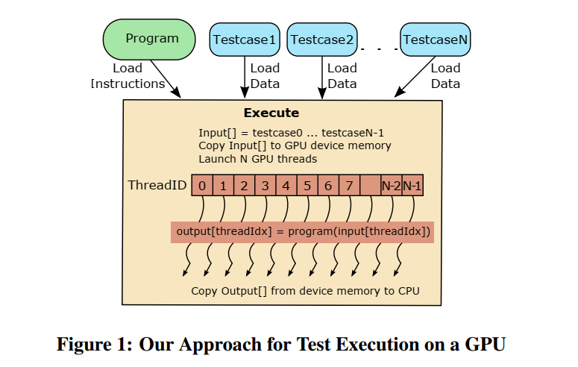
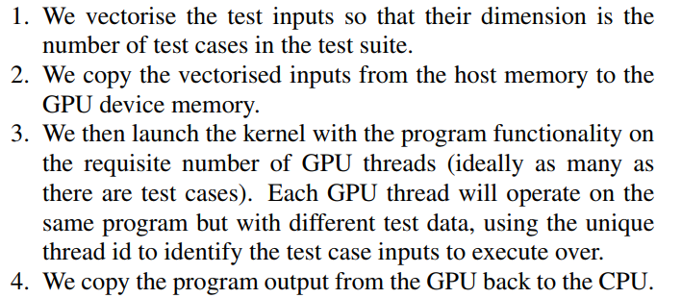
The suggested approach

Slide 6
speed-ups up to a factor of 27

Slide 7
Tech Requirements
Simultaneous execution of test cases using GPUs
Each test case runs on a separate GPU thread, independent of other test cases.
GPU device management code acts as a wrapper for the original program.
No thread synchronization is needed due to the independence of test case executions.

Slide 8
Tech Requirements
GPU Advantages
Massively parallel processors with unmatched multi-threaded performance
State-of-the-art GPU architectures offer over 1500 GFLOPS, compared to around 100 GFLOPS for traditional CPUs
Energy-efficient and cost-effective compared to multi-core CPUs or PC clusters

Slide 9
Tech Requirements
GPU Advantages
Significant reduction in test suite execution time, leading to cost savings.
Ability to execute more test cases within the same allotted time, increasing fault detection likelihood.

Slide 10
Tech Requirements
General-Purpose computing on GPUs (GPGPU)
Utilizes GPUs for non-graphical tasks, exploiting data-level parallelism
Software testing can benefit from GPUs due to the data parallelism inherent in test case execution

Slide 11
Conclusion
In conclusion, we have demonstrated the potential of GPU acceleration in reducing test suite execution time.
Our approach provides significant benefits, including cost savings, increased fault detection likelihood, and energy efficiency.
Further research can address the limitations and explore broader application domains.

Slide 12
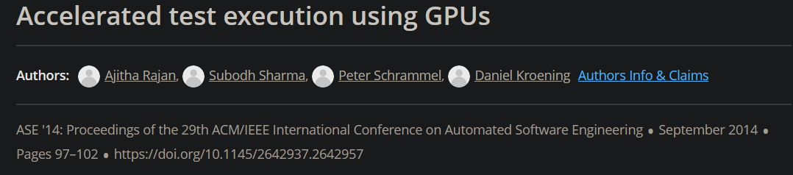
References:

Slide 13

با تشکر از توجه شما

